Slide 1
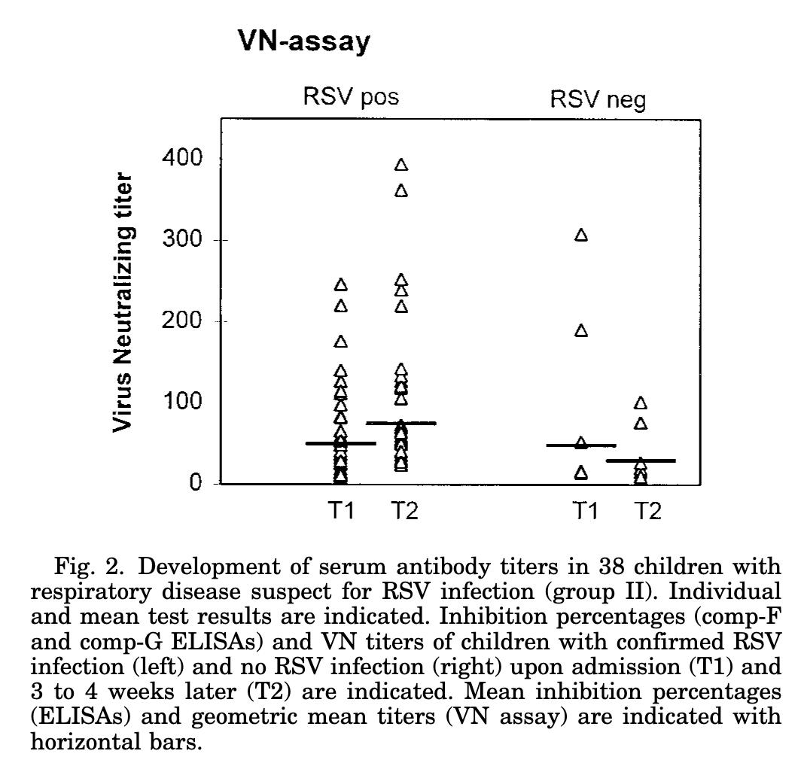

Slide 2
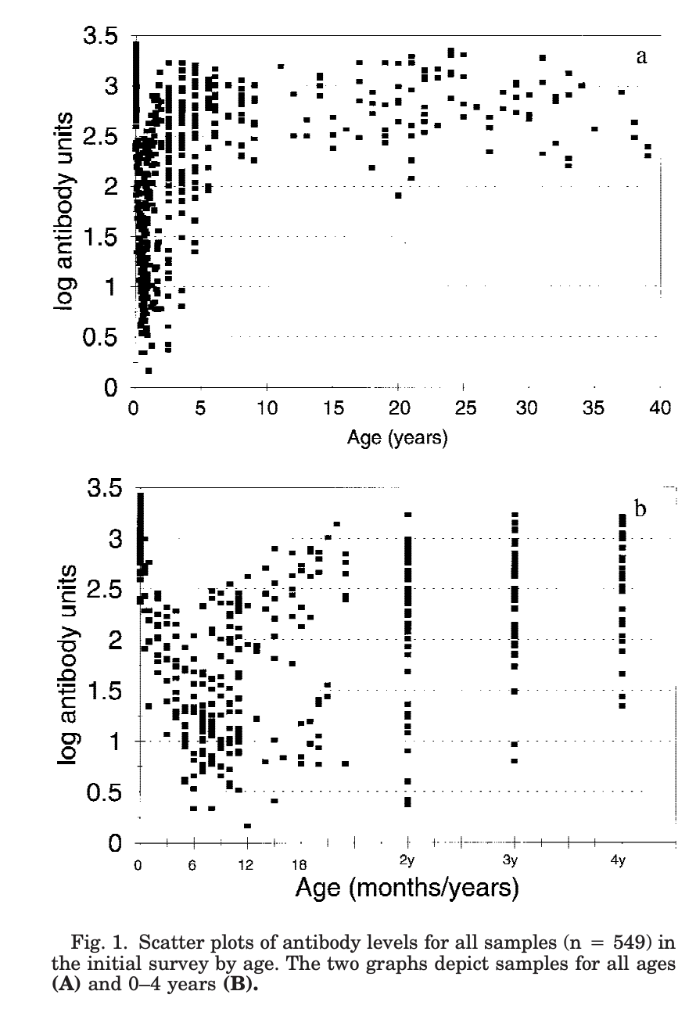
Antibodies in Infants
Maternal antibodies decay and then naturally acquired antibodies increase:
Seroepidemiological Study of Respiratory Syncytial Virus in Sao Paulo State, Brazil
https://onlinelibrary.wiley.com/doi/pdf/10.1002/%28SICI%291096-9071%28199807%2955%3A3%3C234%3A%3AAID-JMV9%3E3.0.CO%3B2-2

Slide 3
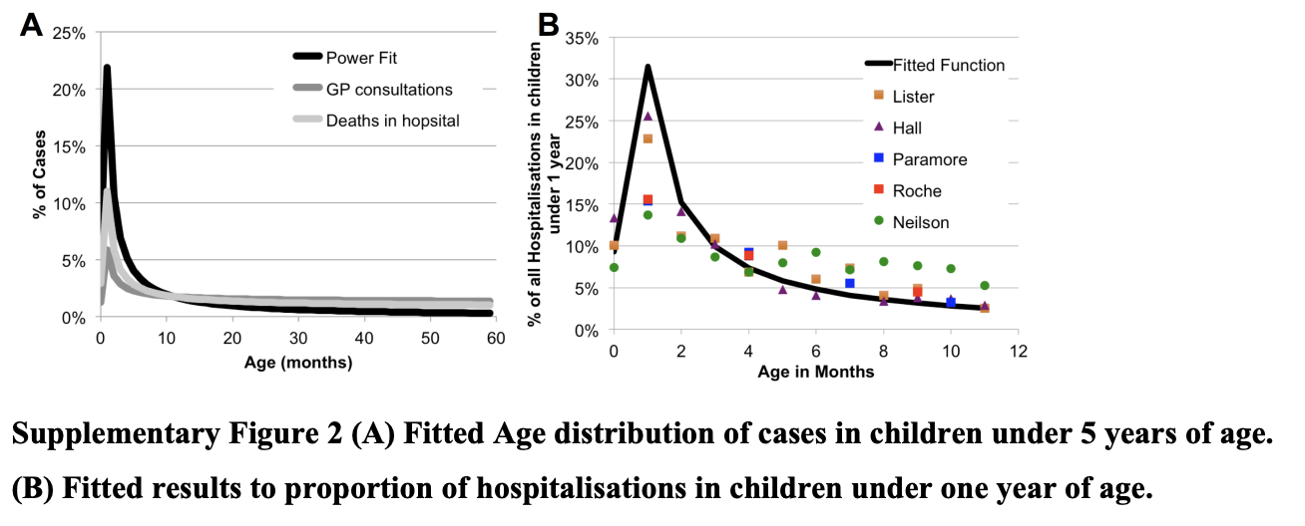
Antibodies in Infants
Proportion of hospitalized cases in children under 1-2 years disease doesn’t fit exactly with antibody distribution.
Burden of paediatric respiratory syncytial virus disease and potential effect of different immunisation strategies: a modelling and cost-effectiveness analysis for England
https://www.sciencedirect.com/science/article/pii/S2468266717301032

Slide 4
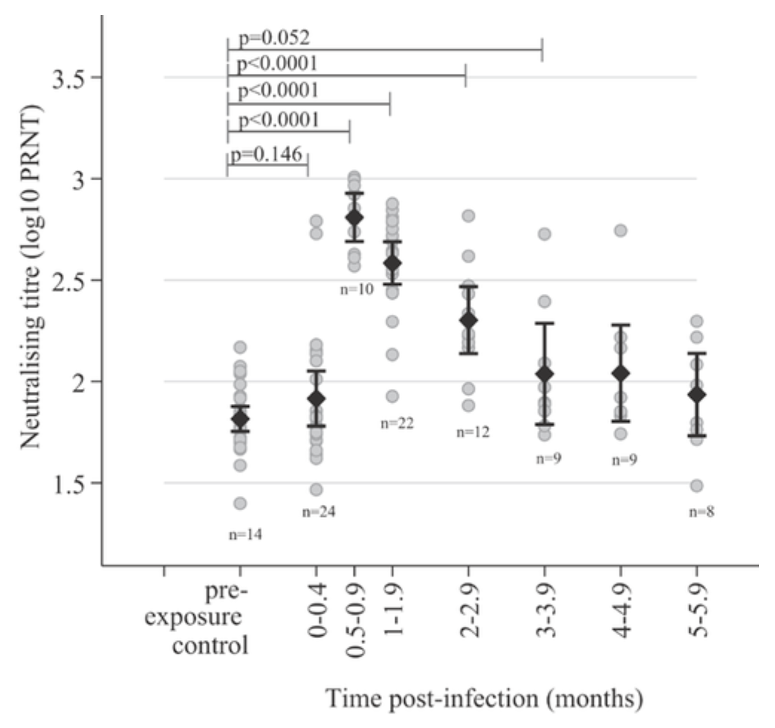
Antibodies in Infants
Naturally acquired Abs also decay quickly
Kinetics of the Neutralizing Antibody Response to Respiratory Syncytial Virus Infections in a Birth Cohort
https://onlinelibrary.wiley.com/doi/10.1002/jmv.23696
Figure 1: Antibodies in Infants

Slide 5
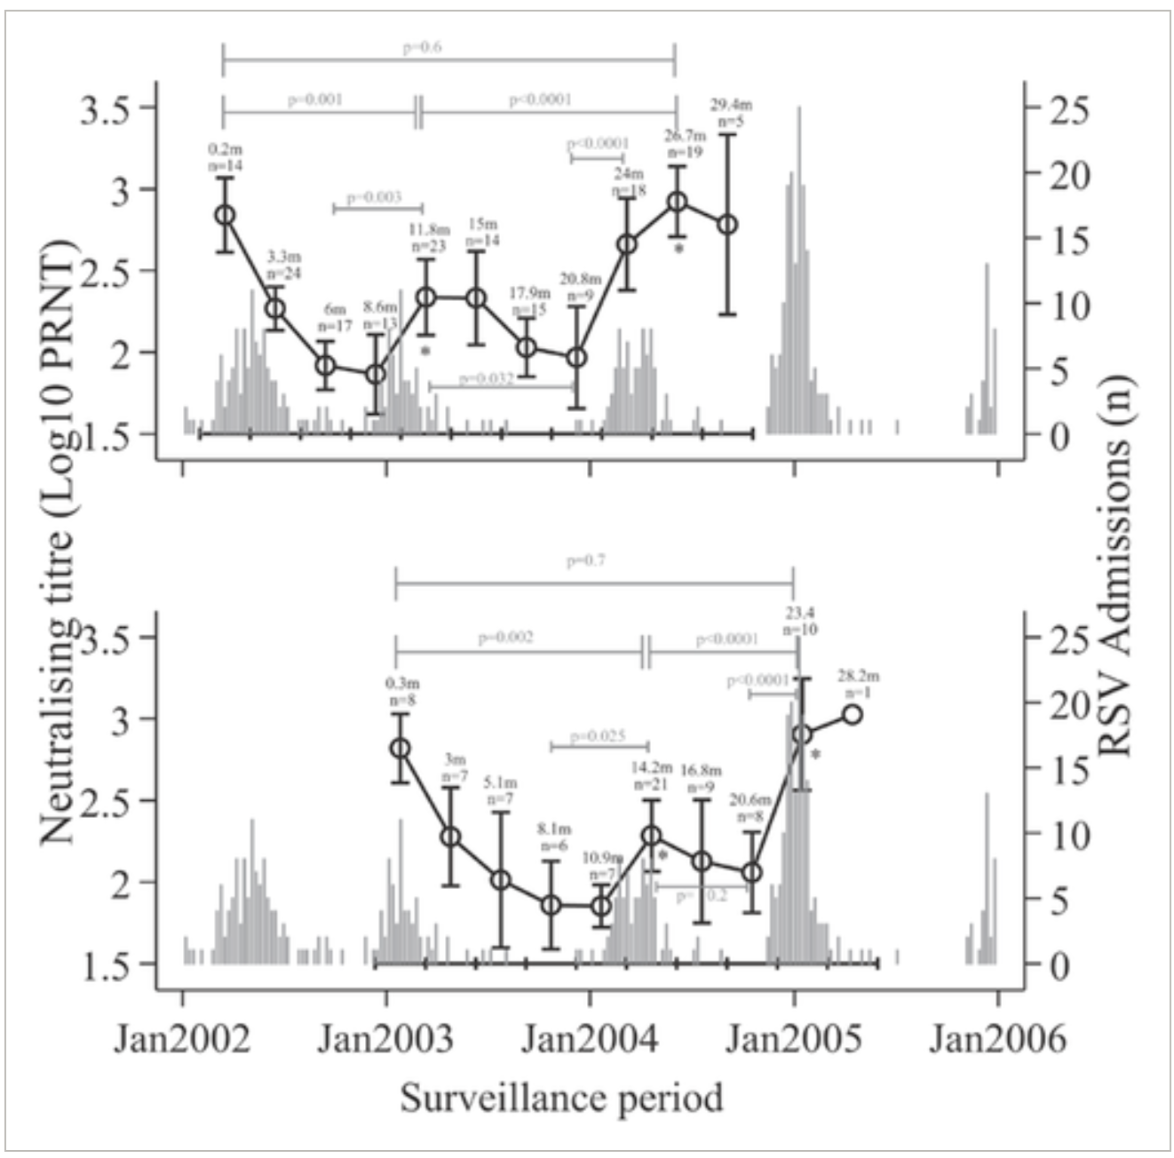
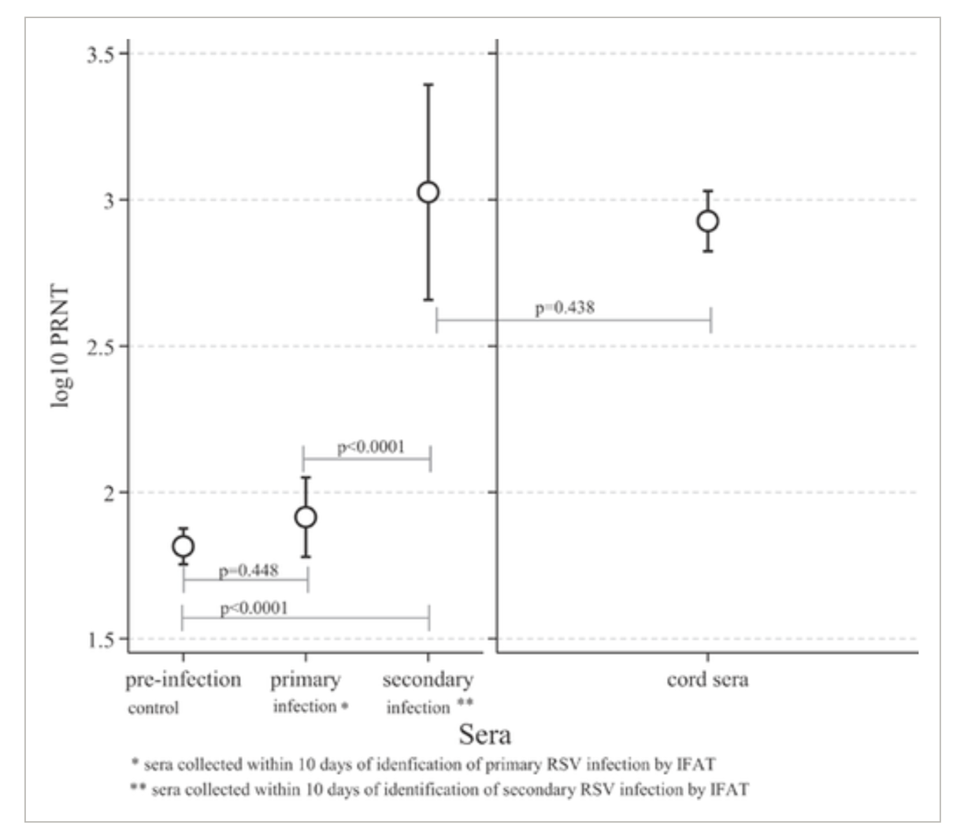
Antibodies in Infants
Takes a couple of infections to get back to birth antibody levels
Figure 2: Antibodies in Infants
Figure 2: Antibodies in Infants relative to RSV seasons
Kinetics of the Neutralizing Antibody Response to Respiratory Syncytial Virus Infections in a Birth Cohort
https://onlinelibrary.wiley.com/doi/10.1002/jmv.23696

Slide 6
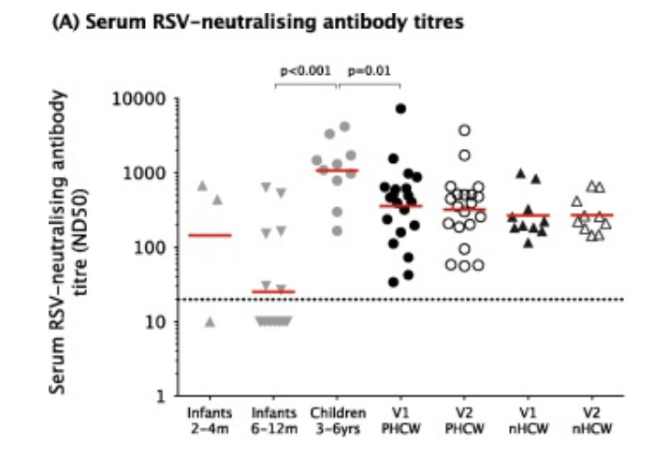
Antibodies in Adults
May not decay as much over time
Humoral and cellular immunity to RSV in infants, children and adults
https://www.sciencedirect.com/science/article/pii/S0264410X1831185X
Figure 1: Antibodies
V1 is at end of RSV season, V2 is 4-6 months later

Slide 7
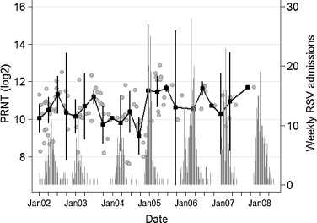
Antibodies in Adults
This is contradicted by the fact that the maternal antibodies in cord blood change relative to the RSV season
Quantifying maternally derived respiratory syncytial virus specific neutralising antibodies in a birth cohort from coastal Kenya
https://www.sciencedirect.com/science/article/pii/S0264410X15002285
Figure 4: Dynamics of cord titres by time and transmission intensity.

Slide 8
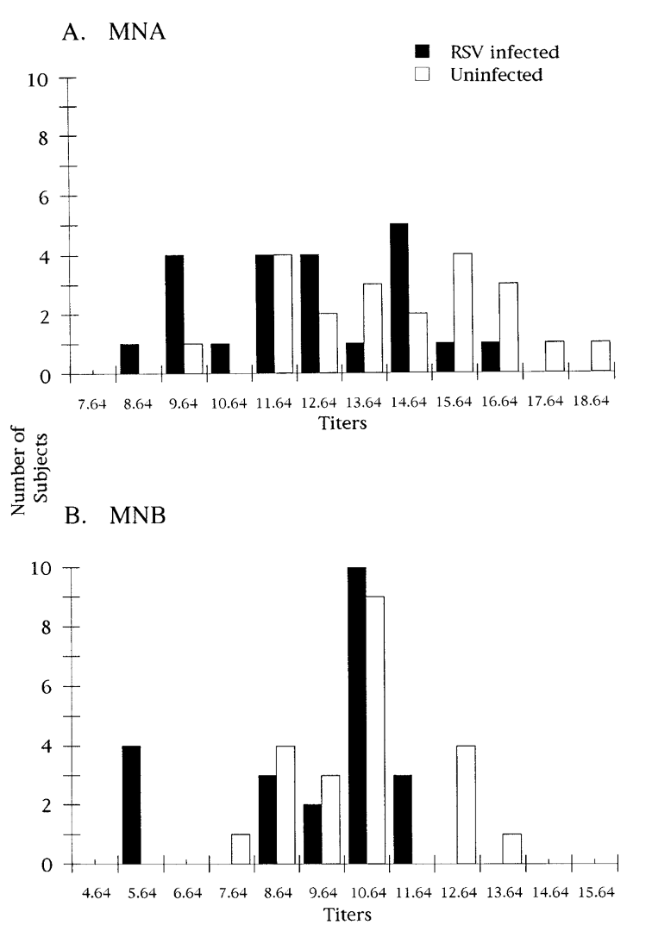
Antibodies in Adults
Elderly who get RSV seem to have lower AB titres
Relationship of Serum Antibody to Risk of Respiratory Syncytial Virus Infection in Elderly Adults
https://academic.oup.com/jid/article/177/2/463/925432
Figure 1: Ab titres by RSV status

Slide 9
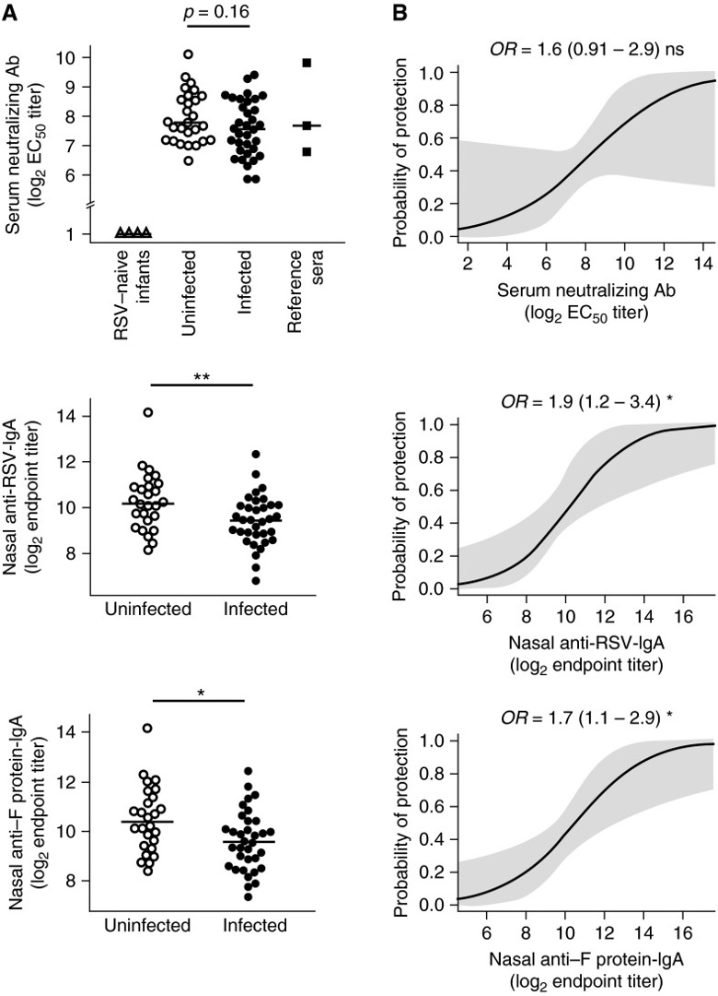
Human Challenge Studies
Antibodies might not be the best correlate of protection from acquisition of infection
Impaired Antibody-mediated Protection and Defective IgA B-Cell Memory in Experimental Infection of Adults with Respiratory Syncytial Virus
https://www.atsjournals.org/doi/10.1164/rccm.201412-2256OC
Figure 1

Slide 10
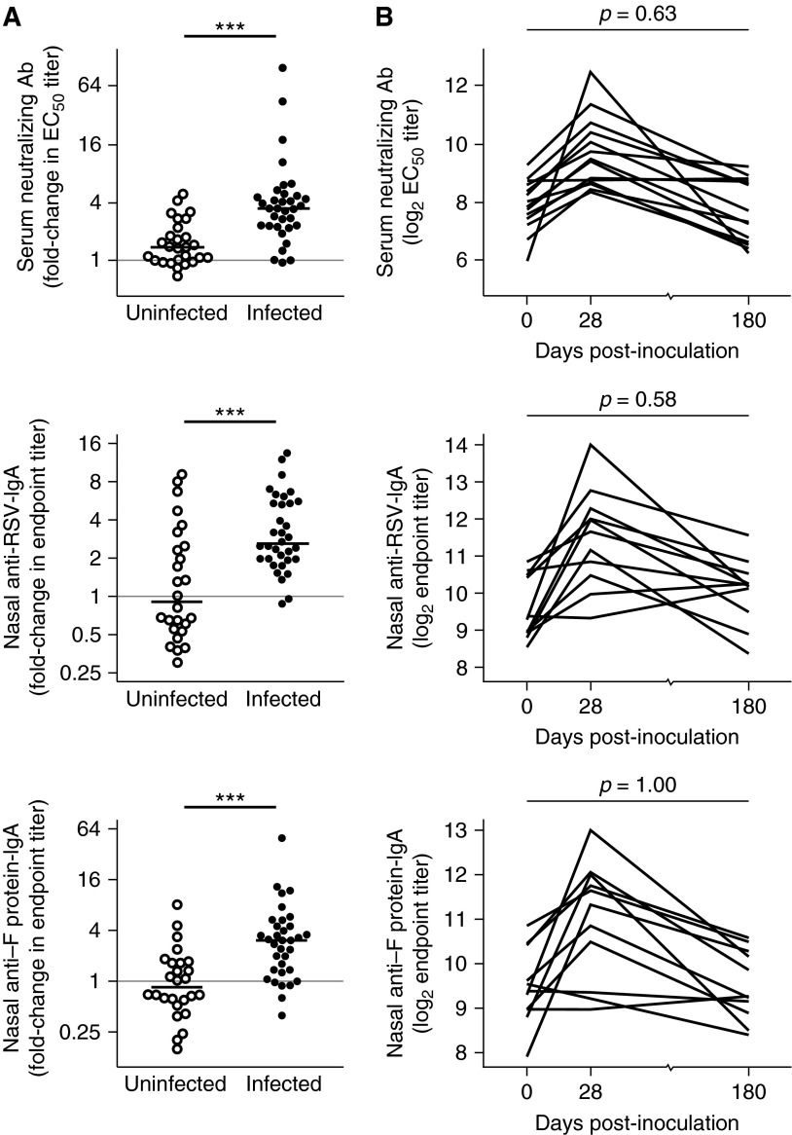
Human Challenge Studies
Antibodies increase after infection, but decrease quickly (contradicting the idea that they don’t decay)
Impaired Antibody-mediated Protection and Defective IgA B-Cell Memory in Experimental Infection of Adults with Respiratory Syncytial Virus
https://www.atsjournals.org/doi/10.1164/rccm.201412-2256OC
Figure 2

Slide 11
Human Challenge Studies
LOOK AT Hall The Journal of Infectious Diseases 1991;163:693-698
Impaired Antibody-mediated Protection and Defective IgA B-Cell Memory in Experimental Infection of Adults with Respiratory Syncytial Virus
https://www.atsjournals.org/doi/10.1164/rccm.201412-2256OC
Figure 2

